Slide 1
(Micro)chips and SLSA
Securing the software supply chain
@riichardboydii
Notes:
Good afternoon everybody! Thanks for sticking around to the end of the day for my talk. We’re at the home stretch and we’ll be out of here and bowling before you know it.

Slide 2

About Me
Technical Principal at Liatrio
DevOpsDays Austin Organizer and Cloud Austin Meetup Organizer
Two decades of experience in systems engineering and DevOps / SRE / Whatever Comes Next
Husband, Father, and Cat Dad
OIF Veteran
@richardboyii on all the things
@richardboydii
Notes:
Technical Principal at Liatrio, we help enterprise customers adopt DevOps fundamentals through pairing and coaching
DevOpsDays Austin Organizer and our event is May 2nd and 3rd this year. I'm also a Cloud Austin Meetup Organizer
I have Two decades of experience in systems engineering and DevOps / SRE / Whatever Comes Next
Husband, Father, and Cat Dad to two stupid kittens and one old cat
OIF Veteran
I'm @richardboydii on all the things

Slide 3
Agenda
Recent Attacks
A changing compliance landscape
SLSA, In-Toto, and Attestations
OPA and Rego Policies
Putting it All Together
Q&A
@richardboydii
Notes:
Recent Attacks
A changing compliance landscape
SLSA, In-Toto, and Attestations
OPA and Rego Policies
Putting it All Together
Q&A

Slide 4
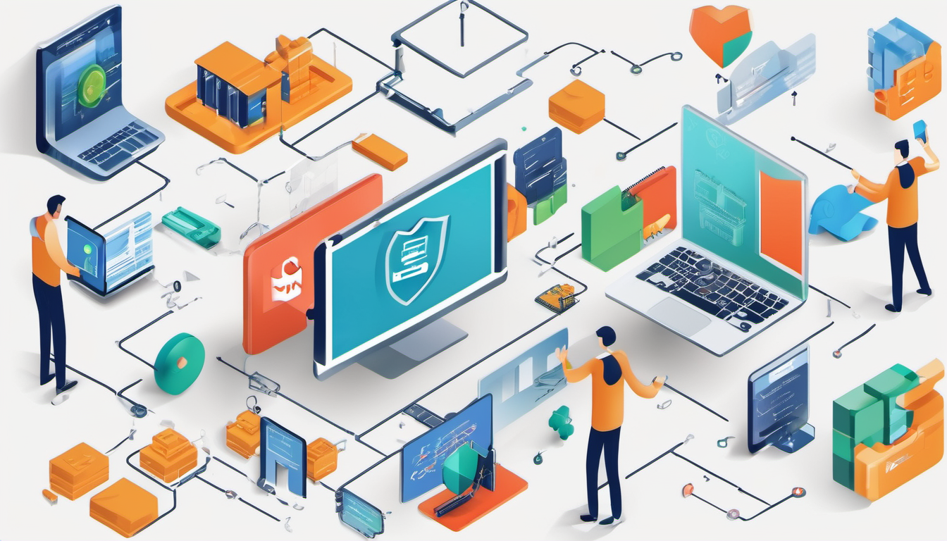
If you think technology can solve your security problems, then you don't understand the problems and you don't understand the technology.
- Bruce Schneier
@richardboydii
Notes:
Whenever I read about trying to fix security issues with software, I think of this quote by Bruce Schneier. In a lot of ways we seem to be trying to fix human-caused security problems with more and more software which creates more vulnerabilities and enlarges the attack surface, doing the opposite of what we actually need to do.
If you think technology can solve your security problems, then you don't understand the problems and you don't understand the technology.
- Bruce Schneier

Slide 5
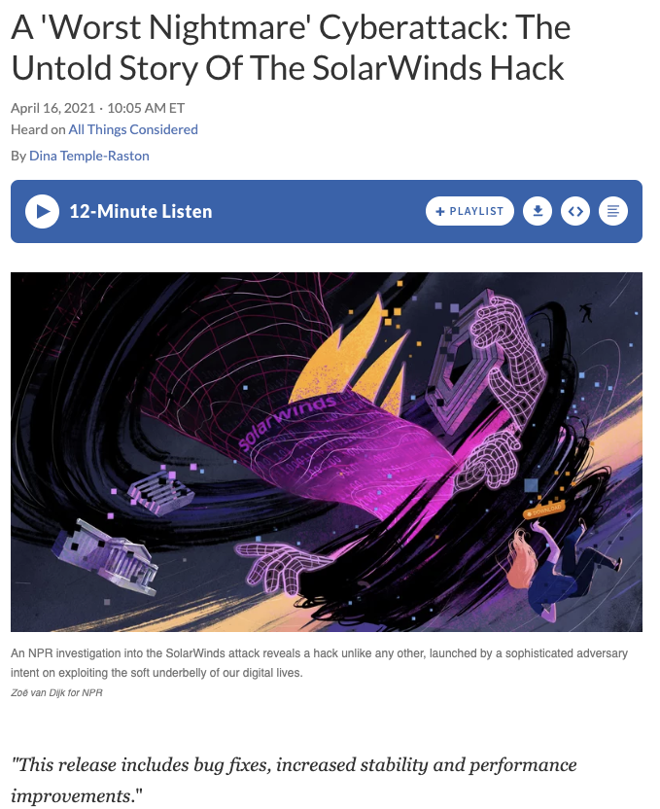
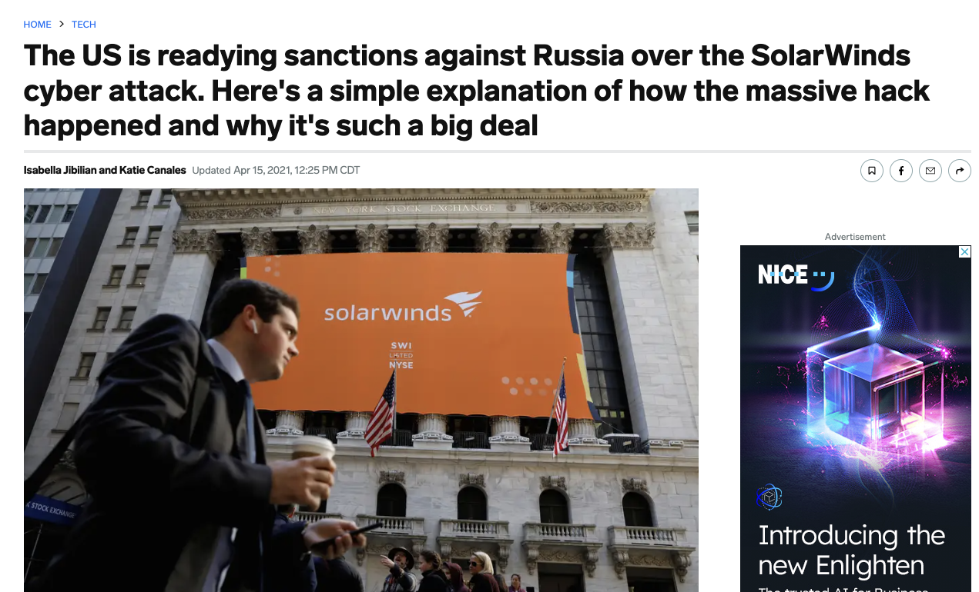
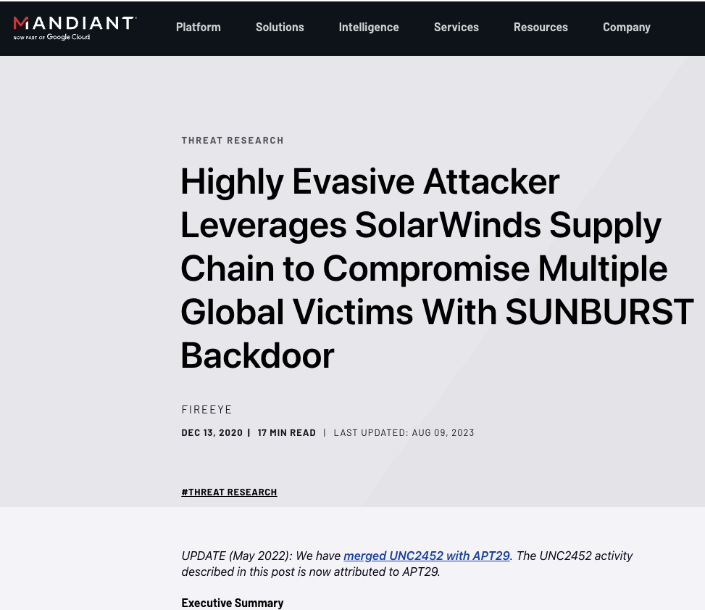
Remember SolarWinds?
@richardboydii
Notes:
Does everyone remember the SolarWinds attack? In case you were in a coma, in October 2019 hackers used a supply chain attack to insert malicious pieces of code into the SolarWinds software update framework. In March of 2020 Solarwinds sent that malicious code out to over 18000 customers. It was a spectacular supply chain attack, perpretrated over a six month period.
In the Orion hack, a backdoor was created which could be accessed by the hackers to impersonate accounts and users of victim organizations. This backdoor allowed the hackers to access system files and hide their tracks by blending into the Orion activity, masking the malicious code from antivirus packages.
Here is a timeline of the SolarWinds hack:
September 2019. Threat actors gain unauthorized access to SolarWinds network
October 2019. Threat actors test initial code injection into Orion
Feb. 20, 2020. Malicious code known as Sunburst injected into Orion
March 26, 2020. SolarWinds unknowingly starts sending out Orion software updates with hacked code
According to a U.S. Department of Homeland Security advisory, the affected versions of SolarWinds Orion are versions are 2019.4 through 2020.2.1 HF1.
More than 18,000 SolarWinds customers installed the malicious updates, with the malware spreading undetected. Through this code, hackers accessed SolarWinds's customer information technology systems, which they could then use to install even more malware to spy on other companies and organizations.

Slide 6
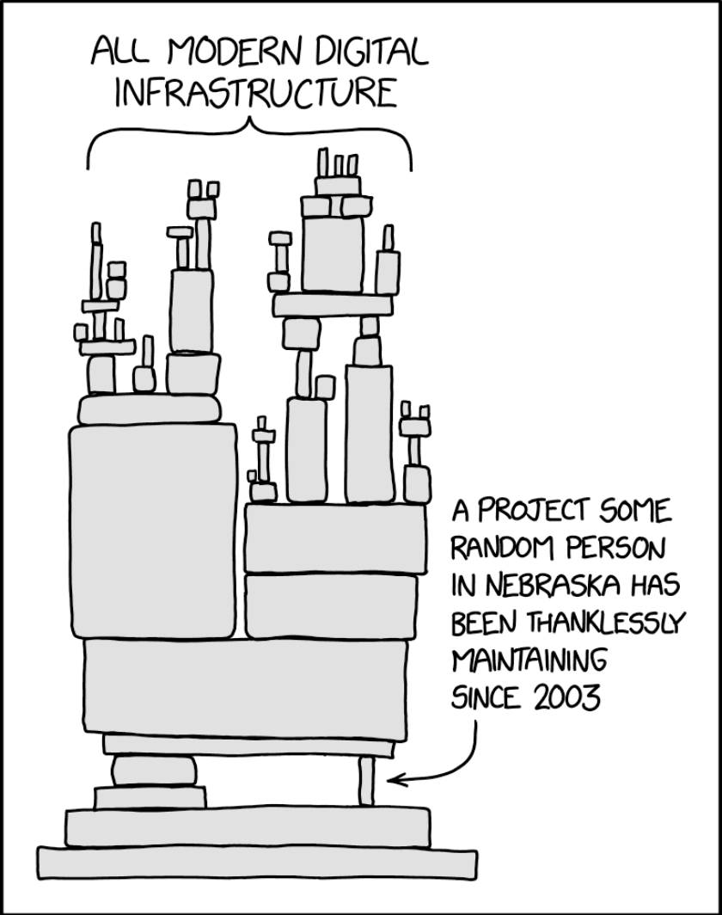
xz
@richardboydii
Notes:
More recently we have the XZ software supply chain attack that used social engineering. Some mysterious person named Jian Tan infiltrated the XZ maintainer community starting all the way back in October of 2021. By February of 2024 they were able to sneak a backdoor into the XZ library. Luckily for all of us, a security researcher, Andres Freund, found the malicious code during performance testing and was able to get the word out to Red Hat and Debian, which issued CVEs and rollbacks respectively.
The XZ software supply chain attack started all the way back in October 2021. The attacker used social engineering to gain the trust of the xz maintainers. Over the course of three years they slowly infiltrated the open source maintainer community and were granted more and more access. The actual attack happened on February 23rd, 2024. Over the next month the attacker would exert pressure on Debian, Red Hat, and Ubuntu to update the xz package with the malicious code. It was finally detected on more than a month later on March 28th, 2024 by Andres Freund. Red Hat assigned a CVE that day and Debian issued a roll back to the previous version without the backdoor. This level of sophistication has not been observed in previous software supply chain attacks and is a harbinger of what attacks going forward may look like. As a consumer of open source software, it behooves us to harden our software supply chains as much as possible.
Timeline on the XZ attack: https://research.swtch.com/xz-timeline

Slide 7
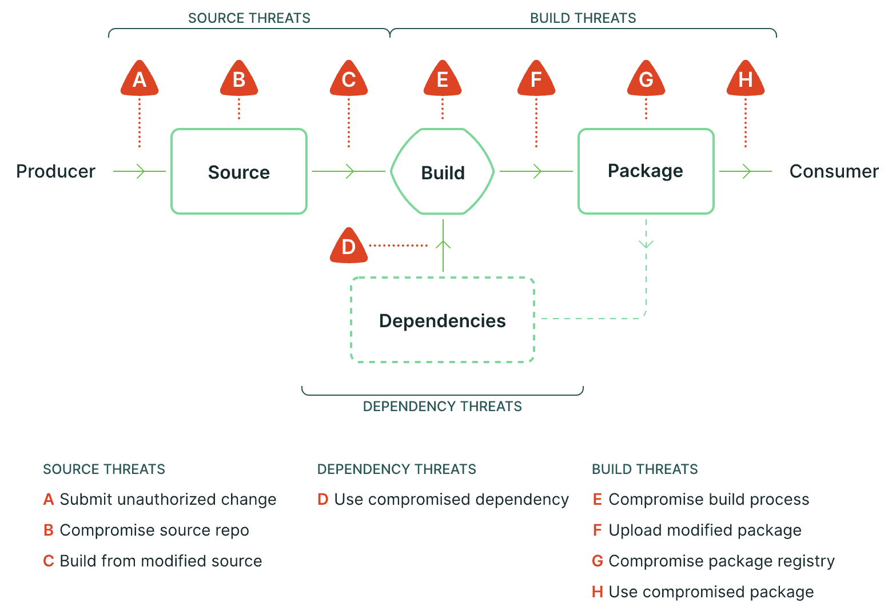
The Software Supply Chain Attack Surface
@richardboydii
Notes:
This is the attack surface of your software supply chain. We’ve taken it for granted that our CI/CD systems and our git repos were secure. What we’ve learned over the past few years is that we now live in a world where we need to harden our software supply chain as much (if not more) than our production systems. From malicious dependency injection to compromised build servers, there’s a huge attack surface that our CI/CD infrastructure presents.

Slide 8
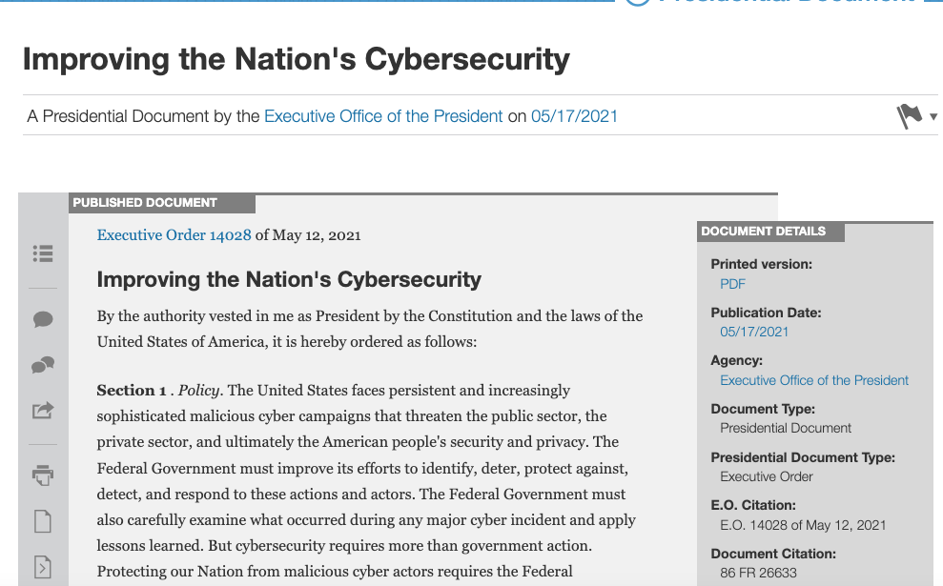
Executive Order 14028
@richardboydii
Notes:
In response to the SolarWinds attack, President Biden issued Executive Order 14028, Aimed at improving the nation’s ability to identify, deter, protect against, detect and respond to malicious cyber activity in the face of “persistent and increasingly sophisticated malicious cyber campaigns that threaten the public sector, the private sector, and ultimately the American people’s security and privacy.”
It mandates encryption at rest and in transit, zero trust architectures, multi-factor authentication, and sets up a threat response and information sharing process between the US government and the private sector. It also mandates that any entity providing software to the US government deliver Software Bill of Materials with their software. And we all know that as the government adopts a standard the rest of the IT industry is compelled to follow.
Mandates encryption at rest and in transit. Requires IT service providers to collect relevant data in case of a cybersecurity incident. Mandates a move towards zero-trust architectures. Mandates MFA. “[t]he development of commercial software often lacks transparency, sufficient focus on the ability of the software to resist attack, and adequate controls to prevent tampering by malicious actors. There is a pressing need to implement more rigorous and predictable mechanisms for ensuring that products function securely, and as intended.”
The new guidance required by the Order will include standards and requirements regarding: (i) secure software development environments; (ii) generating and, when requested by a purchaser, providing artifacts that demonstrate conformance to the guidance; (iii) employing automated tools or processes to maintain trusted source code supply chains and to check for and remediate known and potential vulnerabilities; (iv) providing, when requested by a purchaser, artifacts of the execution of those tools and processes, and making publicly available a summary description of the risks assessed and mitigated; (v) maintaining accurate and up-to-date data, provenance of software code or components, and controls on internal and third-party software components, tools and services, and performing audits and enforcement of these controls; (vi) providing a purchaser a Software Bill of Materials for each product; (vii) participating in a vulnerability disclosure program that includes a reporting and disclosure process, and attesting to conformity with secure software development practices; and (viii) ensuring and attesting, to the extent practicable, to the integrity and provenance of open-source software used within any portion of a product.
The risk responsibility for software is shifting from software consumers to software producers. This is what this executive order is focused on.

Slide 9
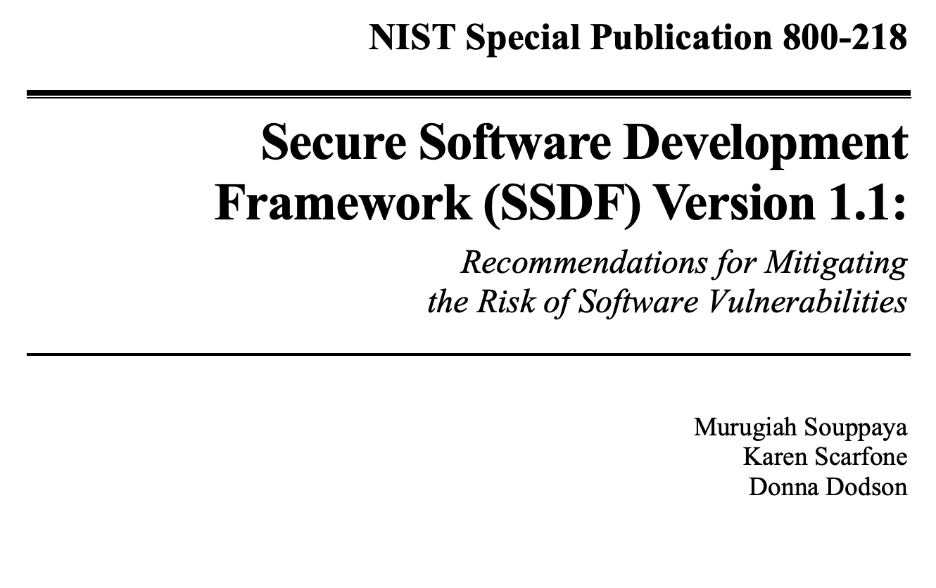
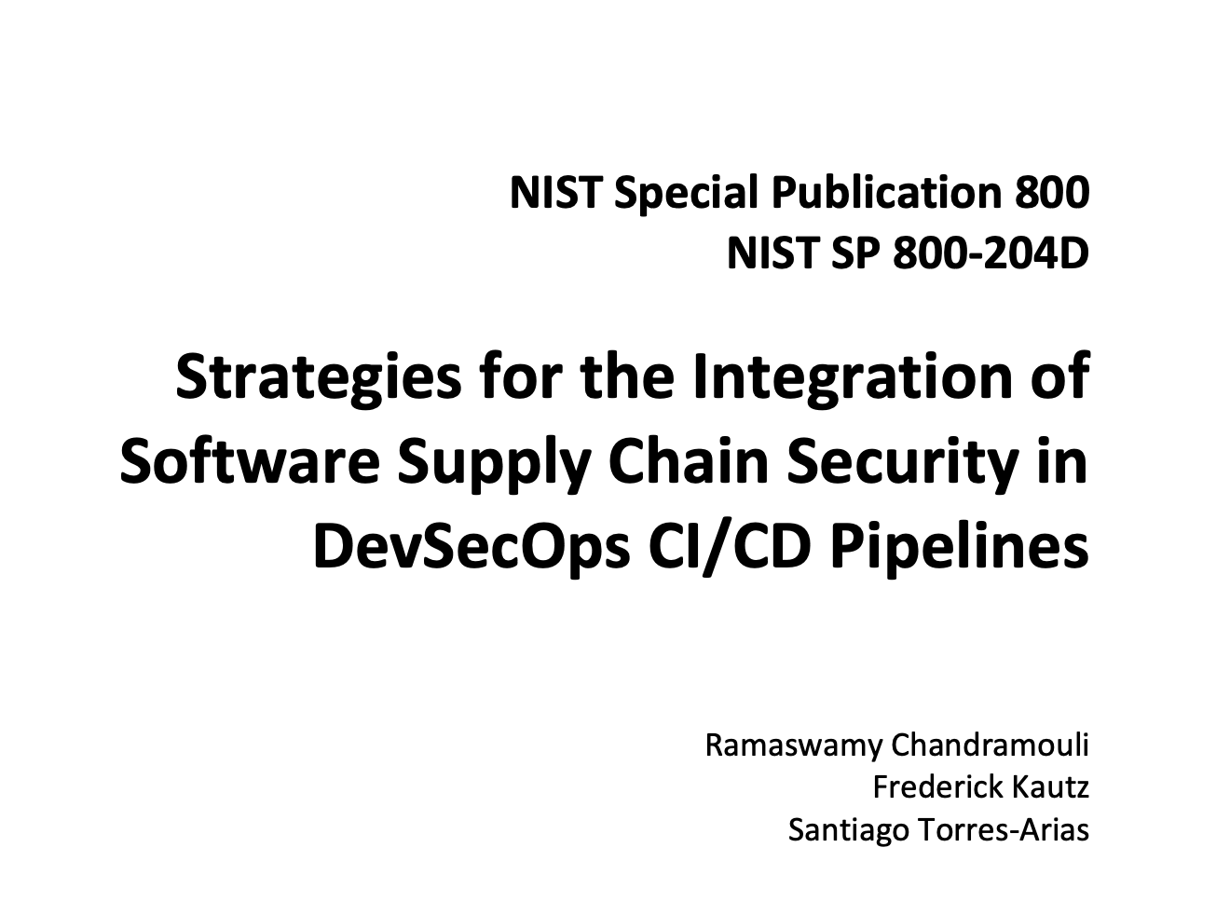
NIST SP 800-218 and 204D
@richardboydii
Notes:
As a consequence of the Executive Order, NIST released updated guidance in the form of two special publications: 800-218 and 800-204D.
NIST SP 800-218
The National Cybersecurity Strategy makes the case that there must be a shift of the burden for cybersecurity from the consumers of software to the producers of software.
It lays out a series of guiding principles that it encourages agencies and the private sector to adopt, including:
PS.3.1: Securely archive the necessary files and supporting data (e.g., integrity verification information, provenance data) to be retained for each software release.
PS.3.2: Collect, safeguard, maintain, and share provenance data for all components of each software release (e.g., in a software bill of materials [SBOM]).
PW.4.4: Verify that acquired commercial, open-source, and all other third-party software components comply with the requirements, as defined by the organization, throughout their life cycles.
NIST 800-204D
NIST SP 800-204D can be thought of as a roadmap designed to navigate the complexities of securing the software supply chain. It offers more than just technical guidance; it fosters a cultural shift within organizations, emphasizing the importance of considering security at every step, from the initial lines of code to the final deployment.
This holistic approach builds trust, both internally and externally. Developers gain confidence knowing their creations are secure, and users can rely on applications that are robust and resilient against potential attacks. In essence, NIST SP 800-204D empowers organizations to build stronger, more secure software, solidifying their footing in the ever-evolving digital landscape.

Slide 10
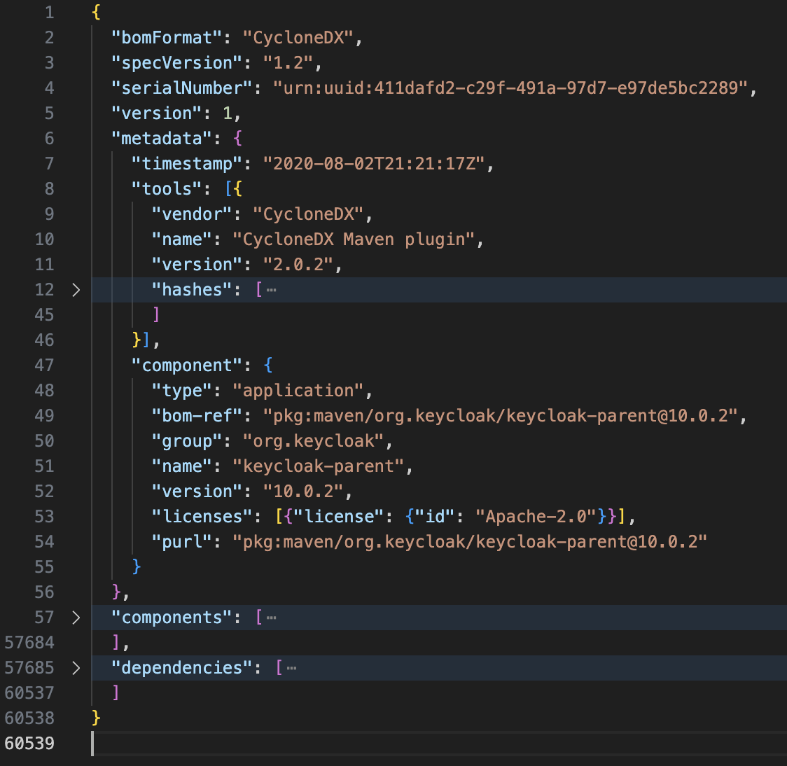
Making SBOMs Actionable
Human readable != having time to read them
Choose a format and stick to it (SPDX vs CycloneDX vs SWID)
Index them and make them searchable using OSS tools like Manticore Search, Apache Solr, or OpenSearch
Don’t forget about data retention requirements; plan ahead (this SBOM is 2.2 MB alone)
@richardboydii
Notes:
This is the Software Bill of Materials for Keycloack. It has over 60K lines and contains loads of components and dependencies. While JSON is technically human readable, there’s no way a human could be expected to inspect this by just reading it. And this is just one SBOM. How many open source projects are you using in your infrastructure or product? How many SBOMs do you potentially need to process in order to ensure that your software supply chain is secure?
When it comes to handling SBOMs make sure to:
Choose a format and stick to it (SPDX vs CycloneDX vs SWID)
Index them and make them searchable using OSS tools like Manticore Search, Apache Solr, or OpenSearch
Don’t forget about data retention requirements; plan ahead (this SBOM is 2.2 MB alone)

Slide 11

Mixing up Some SLSA
Supply-chain Levels for Software Artifacts (SLSA)
A checklist of standards and controls to prevent tampering, improve integrity, and secure packages and infrastructure
Software Supply Chains should be tamper proof, e.g. no injections or overrides; hermetic
Build levels validate the security of the software supply chain
Generate provenance about the build process
Just hit version 1.0.0, still evolving
@richardboydii
Notes:
Next up we need to talk about hardening our build systems. That's where the SLSA framework comes in.
Any software can introduce vulnerabilities into a supply chain. As a system gets more complex, it’s critical to already have checks and best practices in place to guarantee artifact integrity, that the source code you’re relying on is the code you’re actually using. Without solid foundations and a plan for the system as it grows, it’s difficult to focus your efforts against tomorrow’s next hack, breach or compromise.
Supply-chain Levels for Software Artifacts (SLSA)
A checklist of standards and controls to prevent tampering, improve integrity, and secure packages and infrastructure
Build levels validate the security of the software supply chain
Software Supply Chains should be tamper proof, e.g. no injections or overrides; hermetic
Generate provenance about the build process in the form of attestations
Just hit version 1.0.0, still evolving

Slide 12
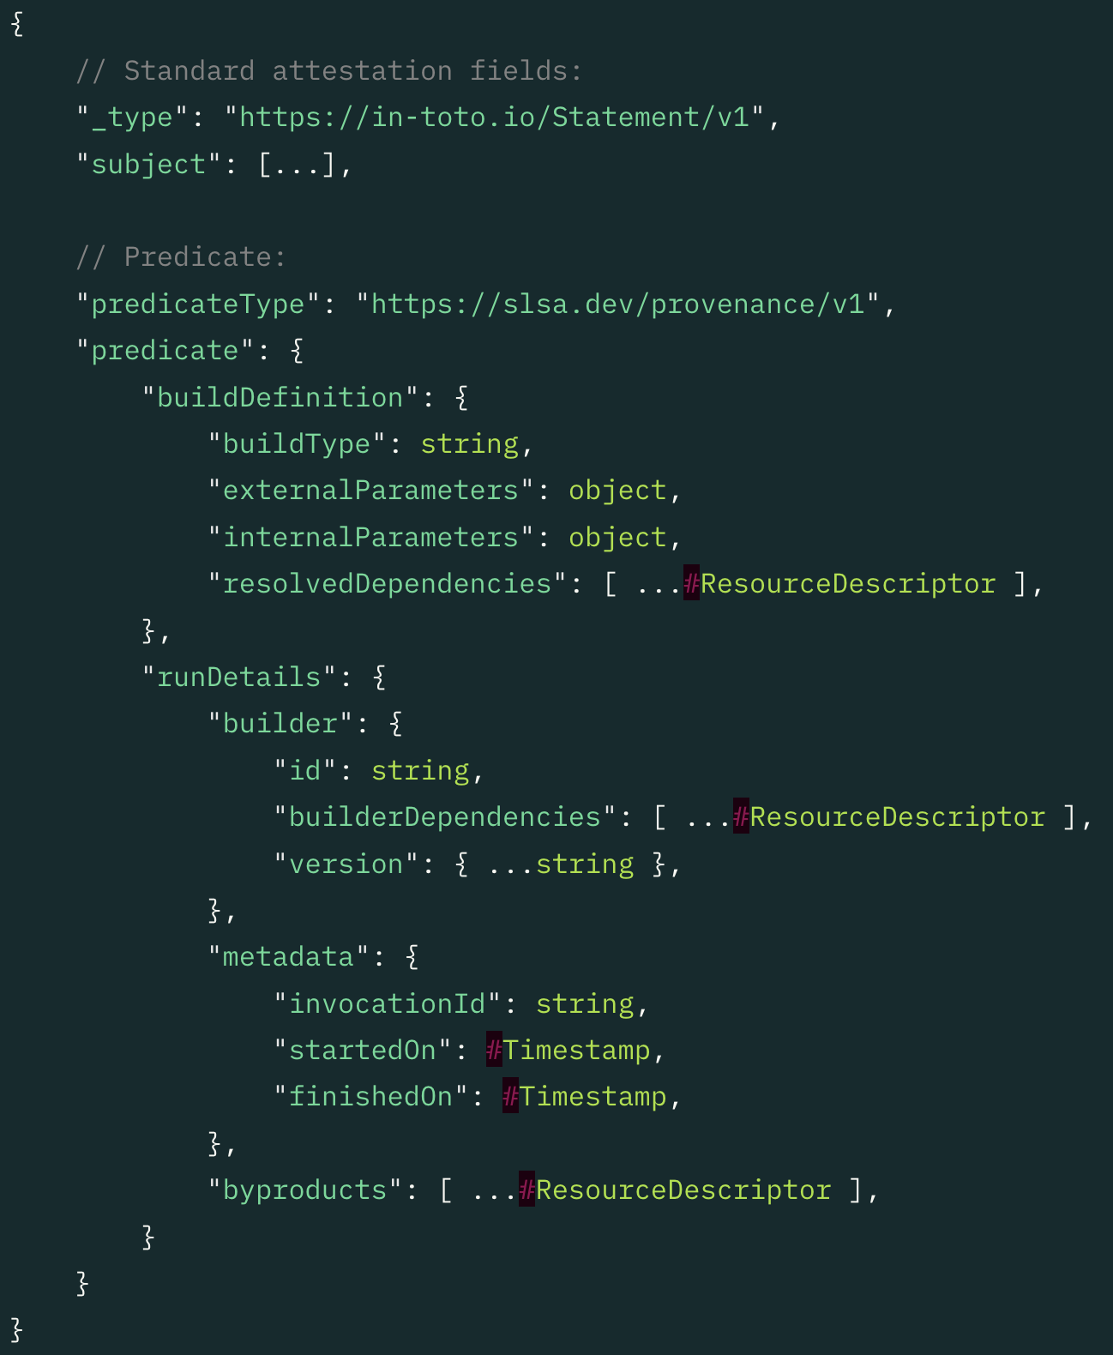
Attestations for the Win
Attestations are like affidavits for how a software artifact was produced
Authenticated metatdata
In-Toto is the common framework for attestations backed by the Linux Foundation
Provide provenance - Verifiable information about software artifacts describing how it was produced
Has four common parts
Predicate
Statement
Envelope
Bundle
@richardboydii
Notes:
Speaking of attestations, the in-toto Attestation Framework provides a specification for generating verifiable claims about any aspect of how a piece of software is produced. Consumers or users of software can then validate the origins of the software, and establish trust in its supply chain, using in-toto attestations.
Authenticated metatdata
In-Toto is the common framework for attestations backed by the Linux Foundation
Provides provenance - Verifiable information about software artifacts describing how it was produced
Four common parts to an attestation
Predicate: Contains arbitrary metadata about a subject artifact, with a type-specific schema.
Statement: Binds the attestation to a particular subject and unambiguously identifies the types of the predicate.
Envelope: Handles authentication and serialization.
Bundle: Defines a method of grouping multiple attestations together.

Slide 13
Types of In-Toto Predicates
SLSA Provenance: Describes how an artifact or set of artifacts was produced.
Link: For migration from in-toto 0.9.
SCAI Report: Evidence-based assertions about software artifact and supply chain attributes or behavior.
Runtime Traces: Captures runtime traces of software supply chain operations.
SLSA Verification Summary: SLSA verification decision about a software artifact.
SPDX: SPDX-formatted BOM for software artifacts.
CycloneDX: CycloneDX BOM for software artifacts.
Vulnerability: Defines the metadata to share the results of vulnerability scanning on software artifacts.
Release: Details an artifact that is part of a given release version.
Test Result: A generic schema to express results of any type of tests.
OR create your own following the conventions
@richardboydii
Notes:
There are wide variety of in-toto predicates out there and more are being added as the specification evolves. From build provenance to SBOMs, there are predicates that you can leverage as-is in your software supply chain. And if you don't find one that fits your use case you can always create a custom predicate following the spec.

Slide 14
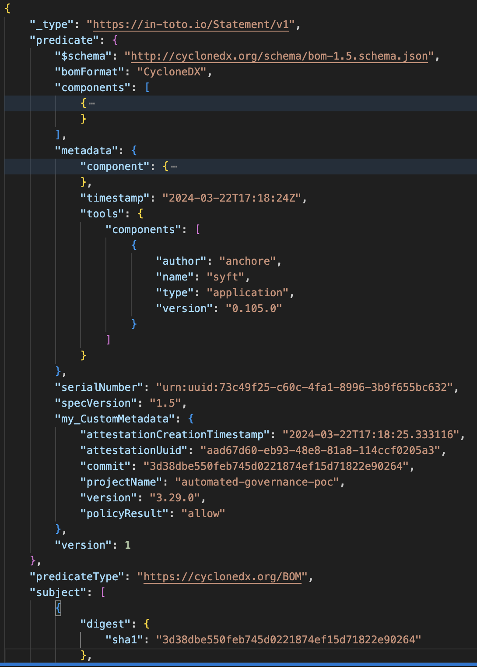
Extension Fields for the Win
Extension fields can be added to an attestation as long as
They SHOULD follow the naming convention of <vendor>_<fieldname>
MUST NOT alter the meaning of any other field
Deleting or ignoring the extension SHOULD NOT turn a policy DENY into an ALLOW
Gives you the ability to increase the usability / utility of attestations
@richardboydii
Notes:
This is a sample attestation that I've generated. I highly recommend that you leverage extension fields to add rich metadata to your attestations to make them more useful.
Extension fields can be added to an attestation as long as
They SHOULD follow the naming convention of <vendor>_<fieldname>
MUST NOT alter the meaning of any other field
Deleting or ignoring the extension SHOULD NOT turn a policy DENY into an ALLOW
In this example I've added fields for the attestation timestamp, the attestation UUID, the commit hash, the project name, the version of software, and the result of policy evaluation.
"my_CustomMetadata": {
"attestationCreationTimestamp": "2024-03-22T17:18:25.333116",
"attestationUuid": "aad67d60-eb93-48e8-81a8-114ccf0205a3",
"commit": "3d38dbe550feb745d0221874ef15d71822e90264",
"projectName": "automated-governance-poc",
"version": "3.29.0",
"policyResult": "allow"
},
"version": 1

Slide 15



The Sigstore Stack
Cosign is used to sign OCI containers and other artifacts
Can also generate and sign attestations
Fulcio is a certificate signing authority for generating short-lived certificates
Rekor is an “immutable, tamper-resistant ledger of metadata generated within a software project’s supply chain”
@richardboydii
Notes:
When it comes to creating, signing, and storing attestations, we’ve had great success leveraging the Sigstore stack. These tools combine to create a feature-rich ecosystem that’s easy to implement.
Cosign is used to sign OCI containers and other artifacts
Can also generate and sign attestations
Fulcio is a certificate signing authority for generating short-lived certificates that Cosign uses when it signs artifacts and attestations
Rekor is an “immutable, tamper-resistant ledger of metadata generated within a software project’s supply chain” and is where we store our attestations

Slide 16

OPA!
Open Policy Agent (OPA) unifies policy statements across the stack
CNCF graduated project
Provides a common language (Rego (pronounced RAY-go)) for policies at every level of the software supply chain
Decouples policy decisions from policy enforcement
@richardboydii
Notes:
Now we need to evaluate our attestations against our governance and compliance
The Open Policy Agent (OPA, pronounced “oh-pa”) is an open source, general-purpose policy engine that unifies policy enforcement across the stack. OPA provides a high-level declarative language that lets you specify policy as code and simple APIs to offload policy decision-making from your software. You can use OPA to enforce policies in microservices, Kubernetes, CI/CD pipelines, API gateways, and more.
CNCF graduated project
Provides a common language (Rego (pronounced RAY-go)) for policies at every level of the software supply chain
Decouples policy decisions from policy enforcement

Slide 17
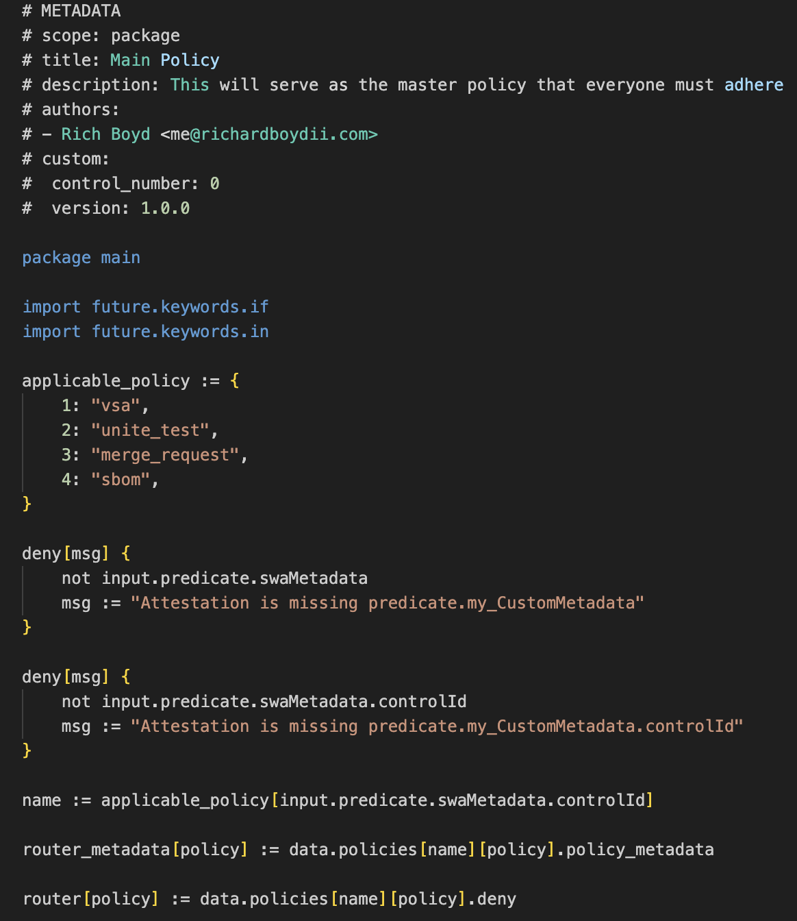
Rego Policy Tips
Leverage the custom metadata fields in the header to add more contextual information
Your main.rego file can act as a router to match policy based on input fields
Use the msg fields to add helper messages to policy allow and deny results
Deny only policies simplify the policies that you need to write
@richardboydii
Notes:
Here are a few tips and tricks to writing your own Rego policies that we've learned over the years.
Leverage the custom metadata fields in the header to add more contextual information like policy information or the version
Your main.rego file can act as a router to match policy based on input fields to other policies
Use the msg fields to add helper messages to policy allow and deny results
Deny only policies simplify the policies that you need to write

Slide 18
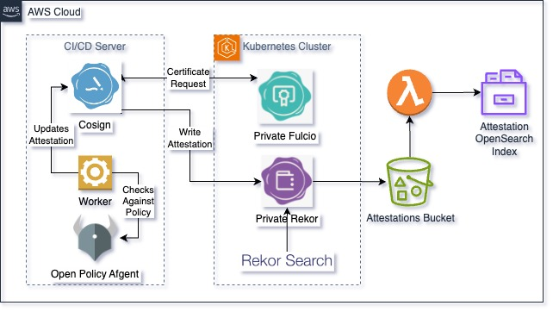
Putting the Pieces Together
@richardboydii
Notes:
We built a secure software supply chain that leveraged the Sigstore stack plus Open Policy Agent. The CI/CD server used Cosign to sign artifacts and attestations. The attestations were then validated against Rego policies in an Open Policy Agent sidecar. The resulting attestation was then signed with a key from Fulcio and uploaded to a private Rekor instance. Rekor Search UI was used to view the full attestation. Rekor stored the attestations in S3, which triggered a Lambda function to write the resulting attestation to an OpenSearch Index for easy analysis by end users / auditors.

Slide 19
Recap
Software supply chain attacks will continue to increase because they’re effective
Securing your software supply chain is a Day 0 duty
Regulations and compliance frameworks are finally catching up to software supply chain attacks
Generating SBOMs is not enough, you have to make them actionable
Attestations provide provenance about how an artifact was constructed and are an essential component of software supply chain security
Rego policies allow you to articulate compliance and governance and evaluate attestations
@richardboydii
Notes:
Software supply chain attacks will continue to increase because they’re effective
Securing your software supply chain is a Day 0 duty
Regulations and compliance frameworks are finally catching up to software supply chain attacks
Generating SBOMs is not enough, you have to make them actionable
Attestations provide provenance about how an artifact was constructed and are an essential component of software supply chain security
Rego policies allow you to articulate compliance and governance and evaluate attestations

Slide 20
Links
Executive Order on Improving the Nation’s Cybersecurity
NIST SP 800-218: Secure Software Development Framework (SSDF) Version 1.1
NIST SP 800-204D Strategies for the Integration of Software Supply Chain Security in DevSecOps CI/CD pipelines
Supply-chain Levels for Software Artifacts (SLSA)
Sigstore
Open Policy Agent

Slide 21
Questions?
@richardboydii on all the things

